Slide 1






Hi, JRC Murthy
Logout
Database Upload
Attendance Upload
Employee Attendance
E
E
Employee ID
Enter
Search Employee
Employee Add/Delete
E
Date
Enter
Test Results
Report Generation
E
Status
Enter
FAQ’s
Latest Updates
Submit
About Us | Terms of Use | GMP Standards | Privacy Policy
Copyright 2019 Shantha Biotechnics Private Limited – All Rights Reserved

Slide 2
Hi, JRC Murthy
Logout
Database Upload
Course Work Addition for Trainee
Employee Attendance
E
E
Employee ID
Enter
Search Employee
Employee Add/Delete
E
Course ID
Enter
Test Results
Report Generation
E
Start Date
Enter
FAQ’s
Latest Updates
Submit
About Us | Terms of Use | GMP Standards | Privacy Policy
Copyright 2019 Shantha Biotechnics Private Limited – All Rights Reserved

Slide 3
Hi, JRC Murthy
Logout
Database Upload
Course Work Progress for Trainee
Employee Attendance
E
E
Employee ID
Enter
Search Employee
Employee Add/Delete
E
Course ID
Enter
Test Results
Report Generation
E
Start Date
Enter
FAQ’s
Latest Updates
E
End Date
Enter
Submit
About Us | Terms of Use | GMP Standards | Privacy Policy
Copyright 2019 Shantha Biotechnics Private Limited – All Rights Reserved

Slide 4
Hi, JRC Murthy
Logout
Database Upload
Employee Attendance
Search Employee
Employee Add/Delete
Test Results
Report Generation
FAQ’s
Latest Updates
About Us | Terms of Use | GMP Standards | Privacy Policy
Copyright 2019 Shantha Biotechnics Private Limited – All Rights Reserved

Slide 5
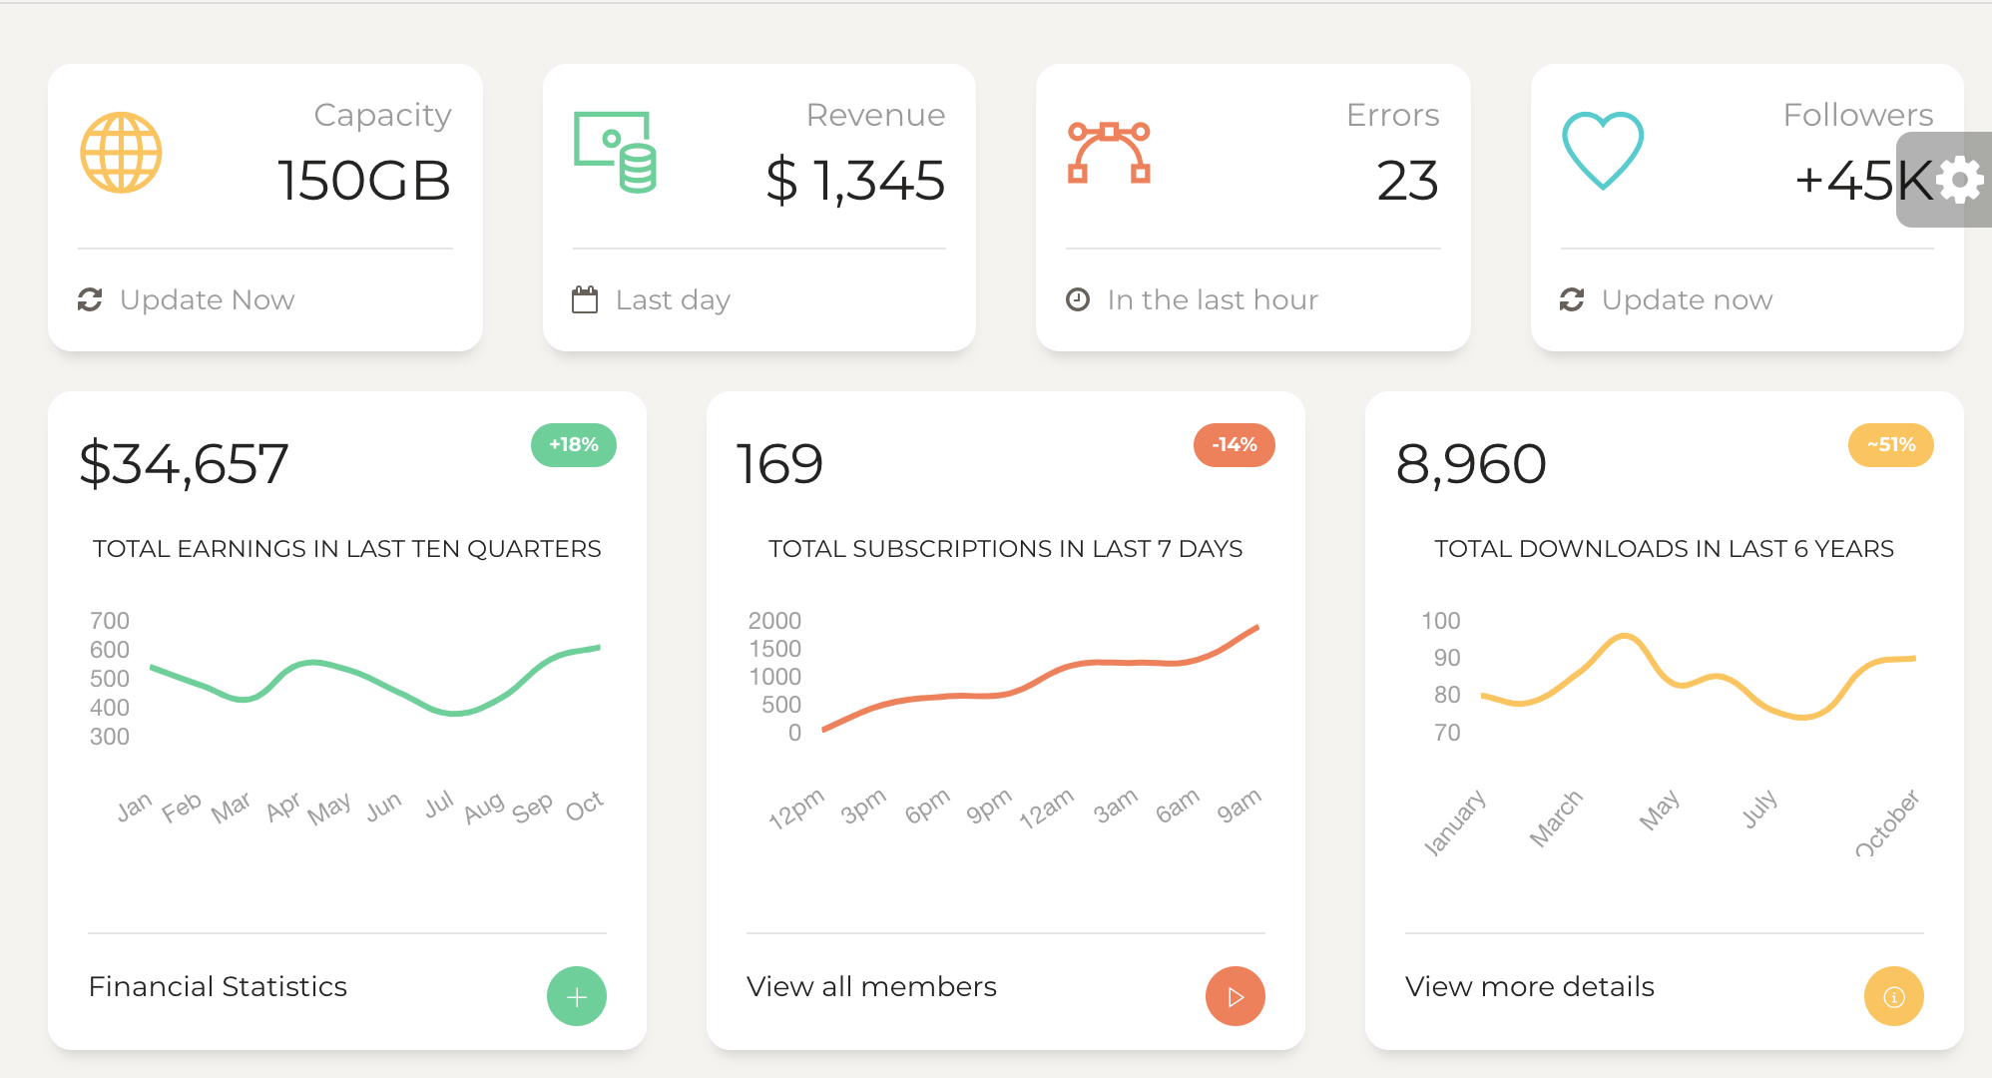
Hi, JRC Murthy
Logout
Generate New Batch
Database Upload
Employee Attendance
Search Employee
Employee Add/Delete
Test Results
Report Generation
FAQ’s
Latest Updates
About Us | Terms of Use | GMP Standards | Privacy Policy
Copyright 2019 Shantha Biotechnics Private Limited – All Rights Reserved

Slide 6
Hi, JRC Murthy
Logout
Database Upload
Employee Attendance
Employee Attendance
E
Employee ID
Enter
Search Employee
Employee Add/Delete
Test Results
Report Generation
FAQ’s
Latest Updates
About Us | Terms of Use | GMP Standards | Privacy Policy
Copyright 2019 Shantha Biotechnics Private Limited – All Rights Reserved

Slide 7
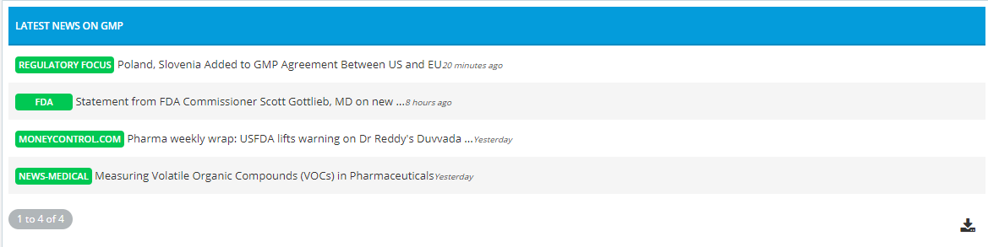
Hi, JRC Murthy
Logout
Latest Updates
Database Upload
Employee Attendance
Search Employee
Employee Add/Delete
Test Results
Report Generation
FAQ’s
Latest Updates
Latest Video Lectures
Documentation
About Us | Terms of Use | GMP Standards | Privacy Policy
Copyright 2019 Shantha Biotechnics Private Limited – All Rights Reserved

Slide 8
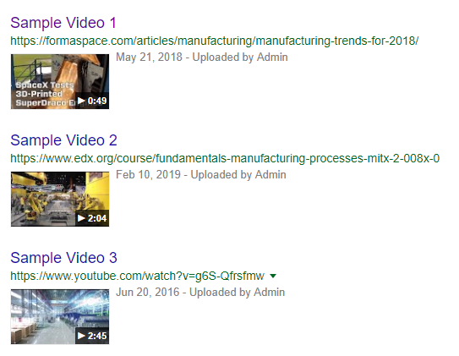
Hi, JRC Murthy
Logout
Latest Video Lectures
Database Upload
Employee Attendance
Search Employee
Employee Add/Delete
Test Results
Report Generation
FAQ’s
Latest Updates
Latest News
Documentation
About Us | Terms of Use | GMP Standards | Privacy Policy
Copyright 2019 Shantha Biotechnics Private Limited – All Rights Reserved

Slide 9
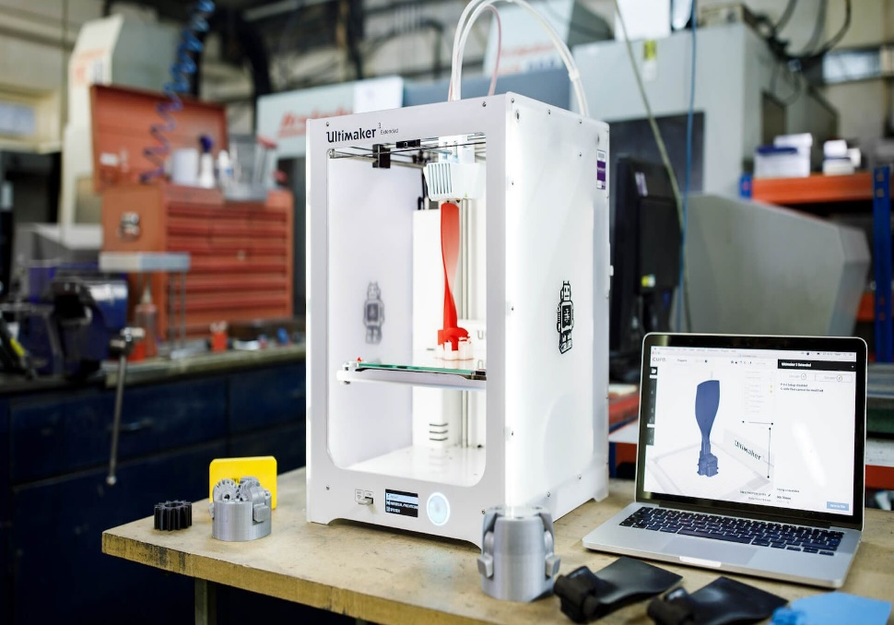
Hi, JRC Murthy
Logout
Latest Documentation
Database Upload
5 Technologies Now Changing Manufacturing
These technologies are having a disruptive impact on the factories of the future
As new technologies start to pervade all areas of our lives, we are beginning to see their application in the manufacturing industry. The German government coined the term ‘Industry 4.0’ which refers to this revolution of manufacturing through technology. While there is certainly some debate around the use of this term – the integration of production methods with the latest developments in computers certainly has the potential to make manufacturing autonomous, cheaper and more efficient. There are lots of ways this could be done, so what can we expect to see in the factory of the future?
1) Ultrafast 3D printing
Up until now, 3D printing has had limited applications in the manufacture of plastics. Making plastic layer by layer is a time consuming and expensive process compared to traditional techniques like injection moulding. However, Neil Hopkinson of the University of Sheffield has been working on a 3D printing technique which will make it economically viable to mass print plastic objects on a huge scale.
Employee Attendance
Search Employee
Employee Add/Delete
Test Results
Report Generation
FAQ’s
Latest Updates
Latest News
Latest Video Lectures
About Us | Terms of Use | GMP Standards | Privacy Policy
Copyright 2019 Shantha Biotechnics Private Limited – All Rights Reserved

Slide 10
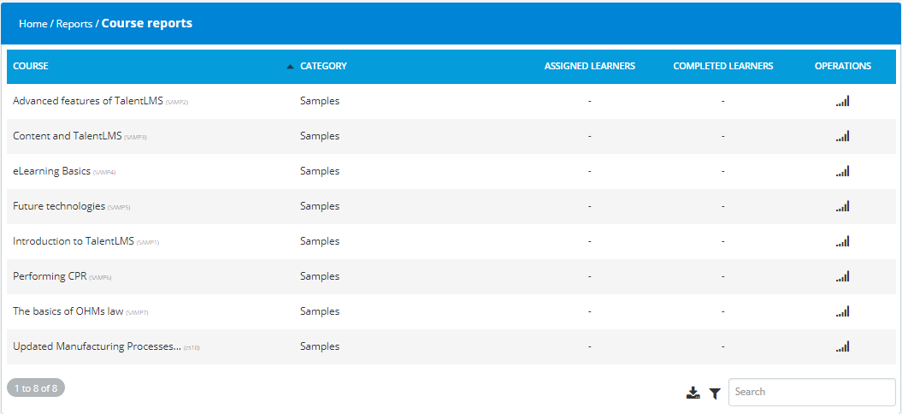
Hi, JRC Murthy
Logout
Database upload
Employee Attendance
E
Search Employee
Employee Add/Delete
Test Results
Report Generation
FAQ’s
Latest Updates
About Us | Terms of Use | GMP Standards | Privacy Policy
Copyright 2019 Shantha Biotechnics Private Limited – All Rights Reserved

Slide 11
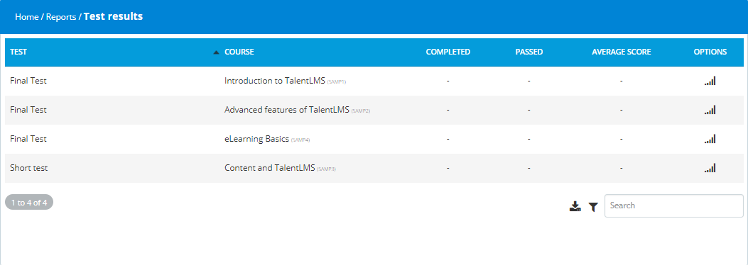
Hi, JRC Murthy
Logout
Database Upload
Employee Attendance
E
Search Employee
Employee Add/Delete
Test Results
Report Generation
FAQ’s
Latest Updates
About Us | Terms of Use | GMP Standards | Privacy Policy
Copyright 2019 Shantha Biotechnics Private Limited – All Rights Reserved

Slide 12
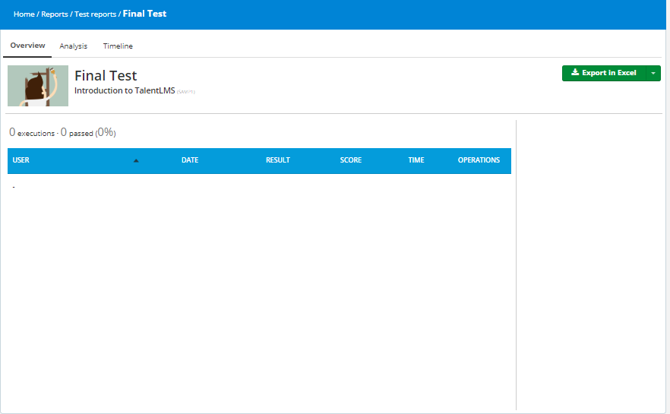
Hi, JRC Murthy
Logout
Database Upload
Employee Attendance
E
Search Employee
Employee Add/Delete
Test Results
Report Generation
FAQ’s
Latest Updates
About Us | Terms of Use | GMP Standards | Privacy Policy
Copyright 2019 Shantha Biotechnics Private Limited – All Rights Reserved

Slide 13
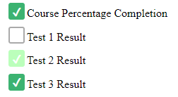
Hi, JRC Murthy
Logout
Database Upload
Alert Trainee
Employee Attendance
E
E
Employee ID
Enter
Search Employee
Employee Add/Delete
E
Course ID
Enter
Test Results
Report Generation
E
Test No.
Enter
FAQ’s
Latest Updates
Send SMS
About Us | Terms of Use | GMP Standards | Privacy Policy
Copyright 2019 Shantha Biotechnics Private Limited – All Rights Reserved

